Slide 1


Slide 2
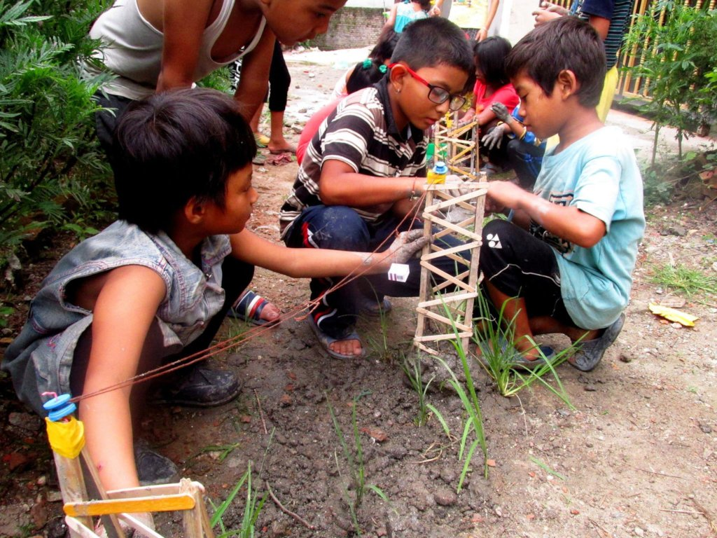
UNIT: 2
PREPARED BY:
Kranti Rajbhandari
Roll no:28
BNS 2nd year
17th batch
PNC TU IOM

Slide 3
General objectives
At the end of this teaching\ learning session, BNS first year students will be able to explain about child to child program and under five clinic.

Slide 4
Specific objectives
At the end of this teaching\ learning session, BNS first year students will be able to
explain about child to child program
explain the areas to organize the child to child program
state the advantages of child to child program

Slide 5
introduce under five clinic
explain the reason for conducting under five clinic
explain the objectives of under five clinic
explain the activities of under five clinic
explain the main component of under five clinic

Slide 6
Child to child program:
Child to child program was designed to involve elder siblings to support younger ones for their development
The first child to child program was started at university of London which was launched in 1978 A.D.

Slide 7
The trend of caring younger siblings by their older one like providing feeding, cleansing, prevention from accident and play therapy along with environment in approach of care is child to child program.
Child to child program or child to child approach is an international network promoting children’s participation in health and development.

Slide 8
Child to child program in Nepal
Child to child program is already introduced in different level of health curriculum in Nepal thought it is not document in official form.
It was taken place in Nepal since late 1980s.
Involvement of child in information, education and communication program through media such as radio, television.

Slide 9
Publication of magazine of children to children by children such as Muna, Koplia.
Involving older children to take care of their younger one in the absence of their parents.
Involving children in developing awareness through sadak natak among children.
Organizing puppet show.

Slide 10
Objectives
To provide the knowledge of basic health care to the children.
To reduce vulnerable health problems among the children.
To provide basic needs of health such as good eating habit, value of nutritious food for health such as vitamin, iron and protein rich food.

Slide 11
cont..
To provide necessary awareness on play therapy and games according to age of children.
To develop healthful behavior among children.
To develop knowledge and skills in first aid and safety precaution

Slide 12
Conti..
To develop responsibility of the children towards improving health of the family and community.

Slide 13
Areas to organize “The child to child program”:
Primary schools
Teachers group
Children who are not going to school
Children local club and organization.

Slide 14
Method and media
Group discussion
Making stories and pictures
Experiment demonstration and drama
Song and poem
Games and health activities

Slide 15
Advantages:
There is no competition for grade. The children learn the importance of trying to help each other.
Child to child program emphasizes on learning through experience rather than simply being told things, the child conduct their own surveys.

Slide 16
Conti..
Perform their own experiments and discover answers for themselves.
In child to child program, children learn to work together and help each other. Older children organize to help and teach younger one. Children get opportunity to learn through sharing.

Slide 17
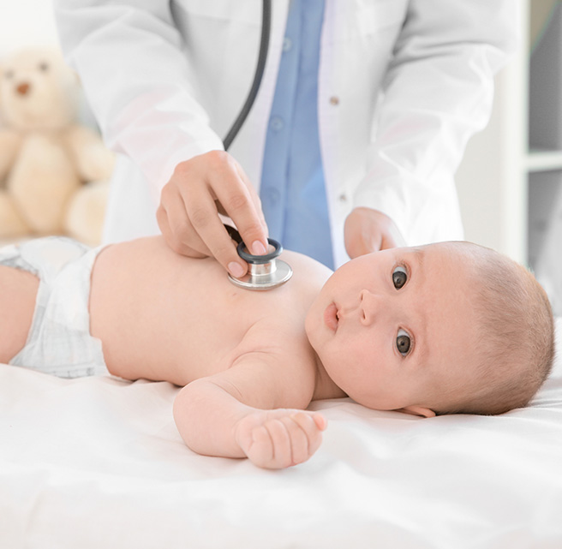

Slide 18
2.3 under five clinic/well baby clinic
Under five clinic/ well baby clinic is a comprehensive health care under one roof where care is provided in a package manner to under five children or preschool children for comprehensive health care in one roof. `

Slide 19
Conti..
It offers preventive, promotive, curative, referral, supervision, nutritional surveillance and educational services within available resources involving non professional auxiliaries, paramedical personnel in the community.

Slide 20
Reason for under five clinic
Under five age groups are vulnerable and special risk group
.
Under five occupy a large sector of total population with high morbidity and high mortality which are preventable with adequate care through immunization, sound nutrition, health education and environmental sanitation

Slide 21
Objectives
To provide comprehensive health care to young children in a specialized facility.
To prevent childhood problem such as malnutrition, tuberculosis, poliomyelitis, diphtheria, tetanus and measles.

Slide 22
Conti..
To provide simple treatment for diarrhea, with or without dehydration, pneumonia, skin condition or other common disorders.
To provide supervision of the health of all children upon the age of five.
To promote the education of parents in order to promote health and family planning.

Slide 23
Cont.
It also emphasize early identification of developmental delay in young children below 2 years of age.

Slide 24
Activities of under five clinic
Registration
History taking
Recording of vital signs
Physical assessment
Assessment of height and weight

Slide 25
Conti..
Maintain growth chart
Immunization services
Treatment of childhood illness
Nutrition and health education including demonstration
Deworming and vitamin A supplementation

Slide 26
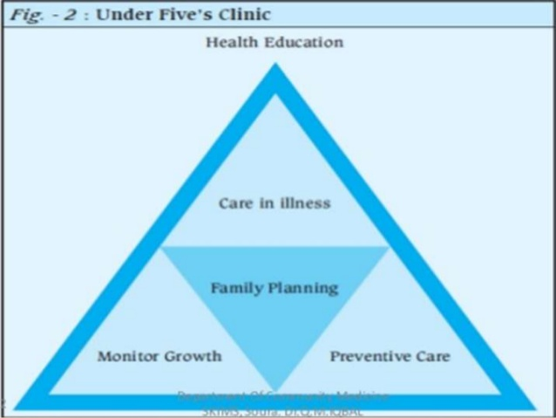

Slide 27
Main component of under five clinic
Care in illness or curative services.
Preventive care.
Immunization
Growth monitoring
Nutritional surveillance
Family planning services
Health check up and timely assessment
Oral rehydration therapy
Environmental sanitation
Health education

Slide 28
Care in illness or curative services
Treatment of common childhood illness such as diarrheal diseases, worm infestation, ARI, skin infection, scabies malnutrition etc.
The curative services include:
Early diagnosis and treatment of acute and chronic illness.
X-ray and lab services.
Referral services.

Slide 29
2. Preventive services
Immunization: most cost effective to protect child from a diseases
Growth monitoring: one month interval up to age of 24 months, after 24 months 2 month interval up to 36 months,4 month interval up to 59months total (24+6+6)
Nutritional surveillance: health education regarding adequate nutrition is provided in under five clinic.

Slide 30
Conti...
Family planning services: parents are counseled on the various options available.
Health check up and timely assessment: it cover physical examination and appropriate laboratory tests.
Oral rehydration therapy: mother are taught about ORS incase of diarrhea in child.

Slide 31
Conti..
Environmental sanitation: should be maintained for child welfare.
Health education: educate the mother about child caring and rearing practice, breast feeding, nutrition, growth monitoring, immunization, cleanliness etc.

Slide 32


Slide 33


Slide 34
Post test
write T for true and F for false statement.
1.Child to child program is first lunched in 1978. [ ]
2.Child to child care is the approach to encourage children’s participation in health promotion and development. [ ]
3.Child to child program develop responsibility of the children towards improving health of the family and community.[ ]

Slide 35
Conti..
4. Child to child program helps to develop healthful behavior among children.[ ]
5. Child to child program helps to child get opportunity to learn through sharing.[ ]
6. Main component of under five clinic are
Care in illness and curative services
Preventive care
Growth monitoring
All of the above

Slide 36
Assignment
Explain about child to child program?
What are the criteria to organize the child to child program?
What are the four activities of saving newborn life (SNL)?
Write short note on under five clinic?
(Date of submission: 2080/09/20)

Slide 37
Plan for next class
We will read about the saving newborn life (unit2.2), play and play therapy (unit 2.5).

Slide 38
References
Adhikari .T, Essential of pediatric nursing 2nd edition (2015),vidhyarthi pustak bhandar, Bhotahity, Kathmandu Nepal, page no.351-352.
Kisi .D, Maharjan.M, Acharya .S, Coprehensive textbook of child health nursing (pediatric nursing),1st edition (2022),Samikshya publication Pvt.Ltd. page no.34-42

Slide 39
Conti..
Shrestha.T, Essential child health nursing 2nd edition (2016), Medhavi publication, Kathmandu Nepal, page no.185-187.
Uprety .K, Child health nursing 4th edition (2071), Tara books and stationary, chhetrapati, Kathmandu, Nepal, page no.73-74.

Slide 40
Uprety .K, Essential of child health nursing 1st edition (2018), Akshav publication, Chhetrapati, Kathmandu, Nepal, page no.745-746.

Slide 41


